Slide 1
SEMESTER III PART II ENGLISH Subject Title: POETRY AND ONE-ACT PLAYS
Prepared by,
B.Rashma ,M.A., NET
Assistant Professor of English
Jamal Mohamed College

Slide 2
OVERVIEW
Introduction
Syllabus
What is Poetry and one-act plays?
The Road Not Taken by Robert Frost
Biography of Robert Frost
Characteristics of frost’s poetry

Slide 3
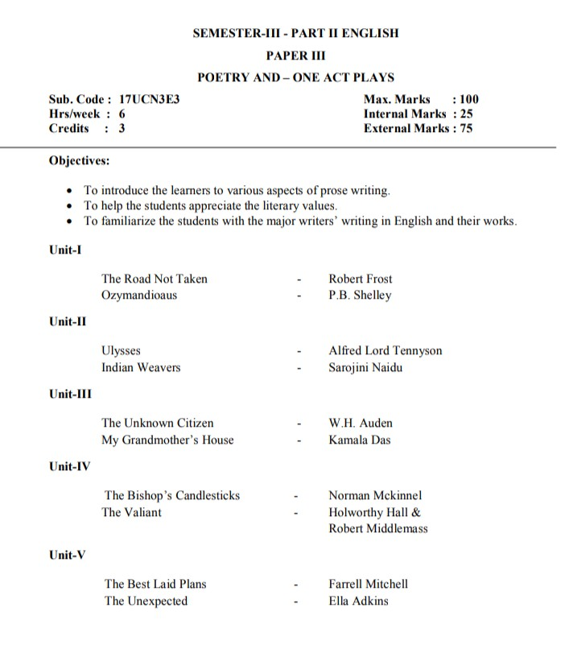
SYLLABUS

Slide 5
Cont…

Slide 6
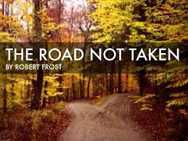
UNIT-1

Slide 7
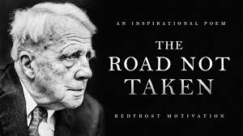
ROBERT FROST
Robert Lee Frost was born on March 26, 1874.
In San Francisco , California.
Most critically respected American poet of 20th century.
Majority of his work had been published in England as well as America.
Best known for his realistic depictions of rural life.(he used nature to represent the complications of life )
In the early 20th cent.. Revolved around rural life in New England – examine complex social and philosophical themes.

Slide 8
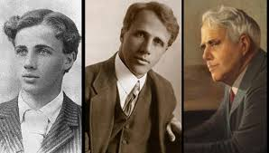
Cont..
CHILDHOOD:
Father – William Prescott Frost (Journalist)
Mother: Isabelle Moodie
After his father’s death , the family moved to Lawrence, Massachusetts(US).
EDUCATION:
Frost graduated from Lawrence High School.
Frost grew up in the city and he published his first poem in his high school’s magazine.
He attended Dartmouth college &Later he joined Harvard University in Boston, but he never earned a formal college degree.
Notes:
BAW-stn

Slide 9
Frost’s Early Poetry
In 1894,Frost had his first poem, “My Butterfly: an Elegy” published in The independent, a weekly literary journal popular in New York City.
In 1906, he wrote two poems :
The tuft of flowers
The trail by existence
When he was 38 yrs old, he found a publisher who would print his first book of poems, A Boy’s will, followed by North of Boston a year later.
Notes:
***Baw-stn

Slide 10
Notable Awards
Pulitzer prize for poetry
Congressional gold medal
Death:
He died in1963 at the age of 88, Boston, Massachusetts, US.

Slide 11
Frost’s most famous poems
The Road Not Taken
Mending Wall
Stopping by Woods on a Snowy Evening
Fire and ice
Birches
Acquainted with the Night
Notes:
***Buhch-uhz

Slide 12
Characteristics of frost’s Poetry:
Clarity and Simplicity
Realism
Symbols
Language, Diction and versification
Philosophy

Slide 13
THE ROAD NOT TAKEN -Robert Frost
INTRODUCTION
Title :
The Road symbolizes “our life”
The path we don’t choose in our life is Road not taken
Describes about the feeling that he left in the past
Chosen Path– decides our future
Be wise while making decision.

Slide 14
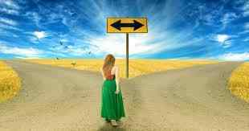
STANZA- I
Two roads diverged in a yellow wood,
And sorry I could not travel both
And be one traveller, long I stood
And looked down one as far as I could
To where it bent in the undergrowth;

Slide 15
STANZA -II
Then took the other, just as fair,
And having perhaps the better claim,
Because it was grassy and wanted wear;
Though as for that the passing there
Had worn them really about the same.

Slide 16
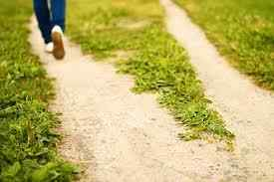
STANZA-III
And both that morning equally lay
In leaves no step had trodden black.
Oh, I kept the first for another day!
Yet knowing how way leads on to way,
I doubted if I should ever come back.

Slide 17
STANZA-IV
I shall be telling this with a sigh
Somewhere ages and ages hence;
Two roads diverged in a wood, and I —
I took the one less travelled by,
And that has made all the difference.

Slide 18
Poetic /Literary Devices
Rhyme scheme: abaab
Two roads diverged in a yellow wood, a
And sorry I could not travel both b
And be one traveller, long I stood a
And looked down one as far as I could a
To where it bent in the undergrowth; b
Symbolism:
two roads-to choices in our life
Road – symbolizes our life
Anaphora: ( repetition of words at the beginning of neighbouring clauses)
Example: and is repeated at the beginning of 2nd ,3rd and 4th lines.

Slide 19
Cont...
Alliteration: wanted wear, first for, though that
Because it was grassy and wanted wear;
Oh, I kept the first for another day!
Though as for that the passing there
Simile: as just as fair- in the second stanza.
Repetition: *Ages is repeated.
* Two roads diverged in a yellow wood ( repeated in 1st and 4th stanzas)

